Slide 1
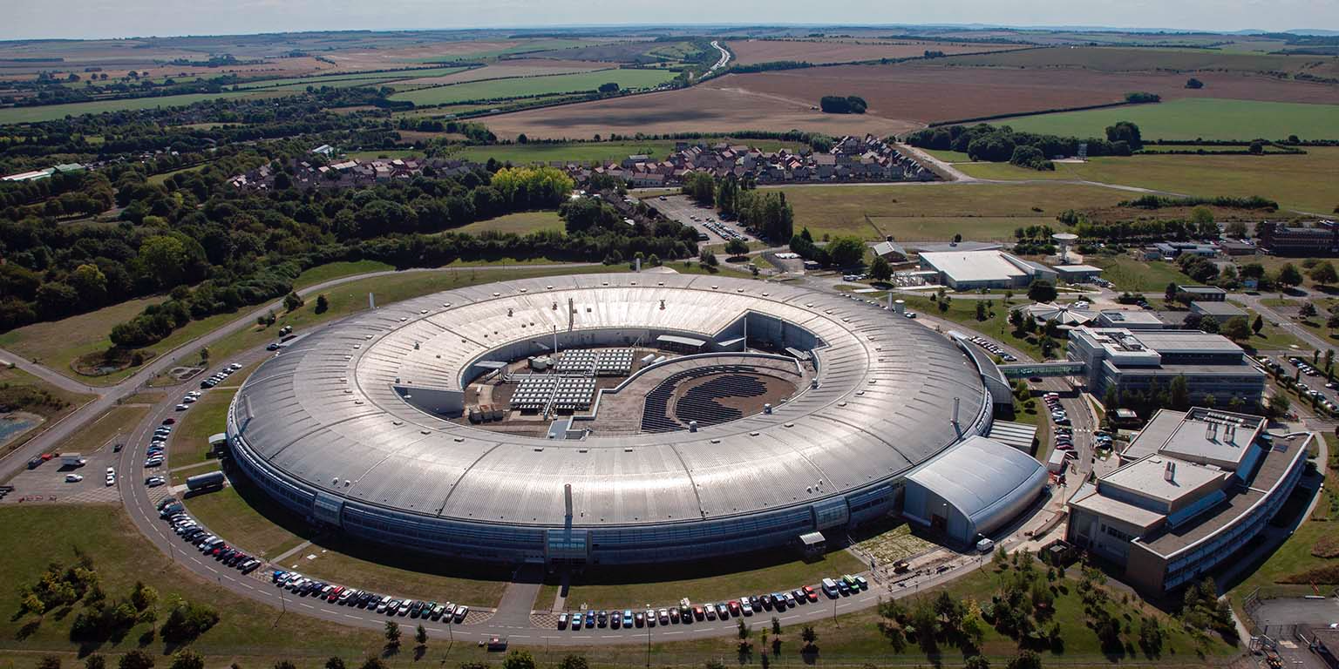


Shaping a modern approach to open data from a World-leading science facility
Terence Tan, DPhil student
Diamond-Oxford Research Project (4 years) – Information Engineer
Data Readiness Group, Department of Engineering Science
University of Oxford
Supervisors: Steve Collins (Diamond), Susanna-Assunta Sansone and Philippe Rocca-Serra (Oxford)
Project Stakeholder Group: Brian Matthews (STFC), Darren Batey (Diamond), David Aragao (Diamond), Francesco Maccherozzi (Diamond), Ian Bush (Diamond), Tim Snow (Diamond), Renaud Duyme (ESRF)

Slide 2
Outline
High level introduction
The FAIR Principles
Research overview
My activities
PaNET ontology - completed
Topic classification for proposals – ongoing
Discussion
Proposal matching system – planned
FAIR for AI - planned
Discussion and feedback

Slide 3

Globally unique and persistent identifiers
To search and retrieve data
Terms of access being maximally open but as restricted as required
To understand how to access data
Standardised terminologies
To assign the same meaning to the same term
Standardised metadata
To make data more discoverable and interpretable
Terms of use and licenses
To encourage innovation and reuse, giving credit as needed
Comprehensive provenance and workflows
To contextualise data and enable its use in practical settings

Slide 4
Research questions
How does the adoption of FAIR Principles at Diamond affect synchrotron data management?
What benefits do the FAIR Principles bring to Diamond as an organisation and to its science life cycle?
How does the implementation of the FAIR Principles contribute to making synchrotron data AI-ready?
Project Stakeholder Group: representing key interests and perspectives

Slide 5
Research activities
1. PaNET
2. Topic classification
3. Proposal matching system
4. 'AI-ready' data
FAIR adoption and benefits
FAIR for AI

Slide 6
Research timeline and key milestones
Oct. 25
2nd Stakeholder Group meeting
Start topic evaluation exercise
Dec. 25
Completion of topic evaluation exercise
Feb. 26
Complete work/submit topic classification paper
Jul. 26
Submission of Confirmation of Status report
Jul. 27
Deadline for submission of thesis
Apr. 24
Transfer of Status completed
Jun. 25
Sep. 25
Dec. 24
1st Stakeholder Group meeting
Generated topics for 5000+ ESRF proposals
Published paper on PaNET
Oct. 23
Start of PhD
Apr. 26
3rd Stakeholder Group meeting to present progress on the other activities
Oct. 26
4th Stakeholder Group meeting
Apr. 27
5th Stakeholder Group meeting
Sep. 26
NOBUGS 15

Slide 7
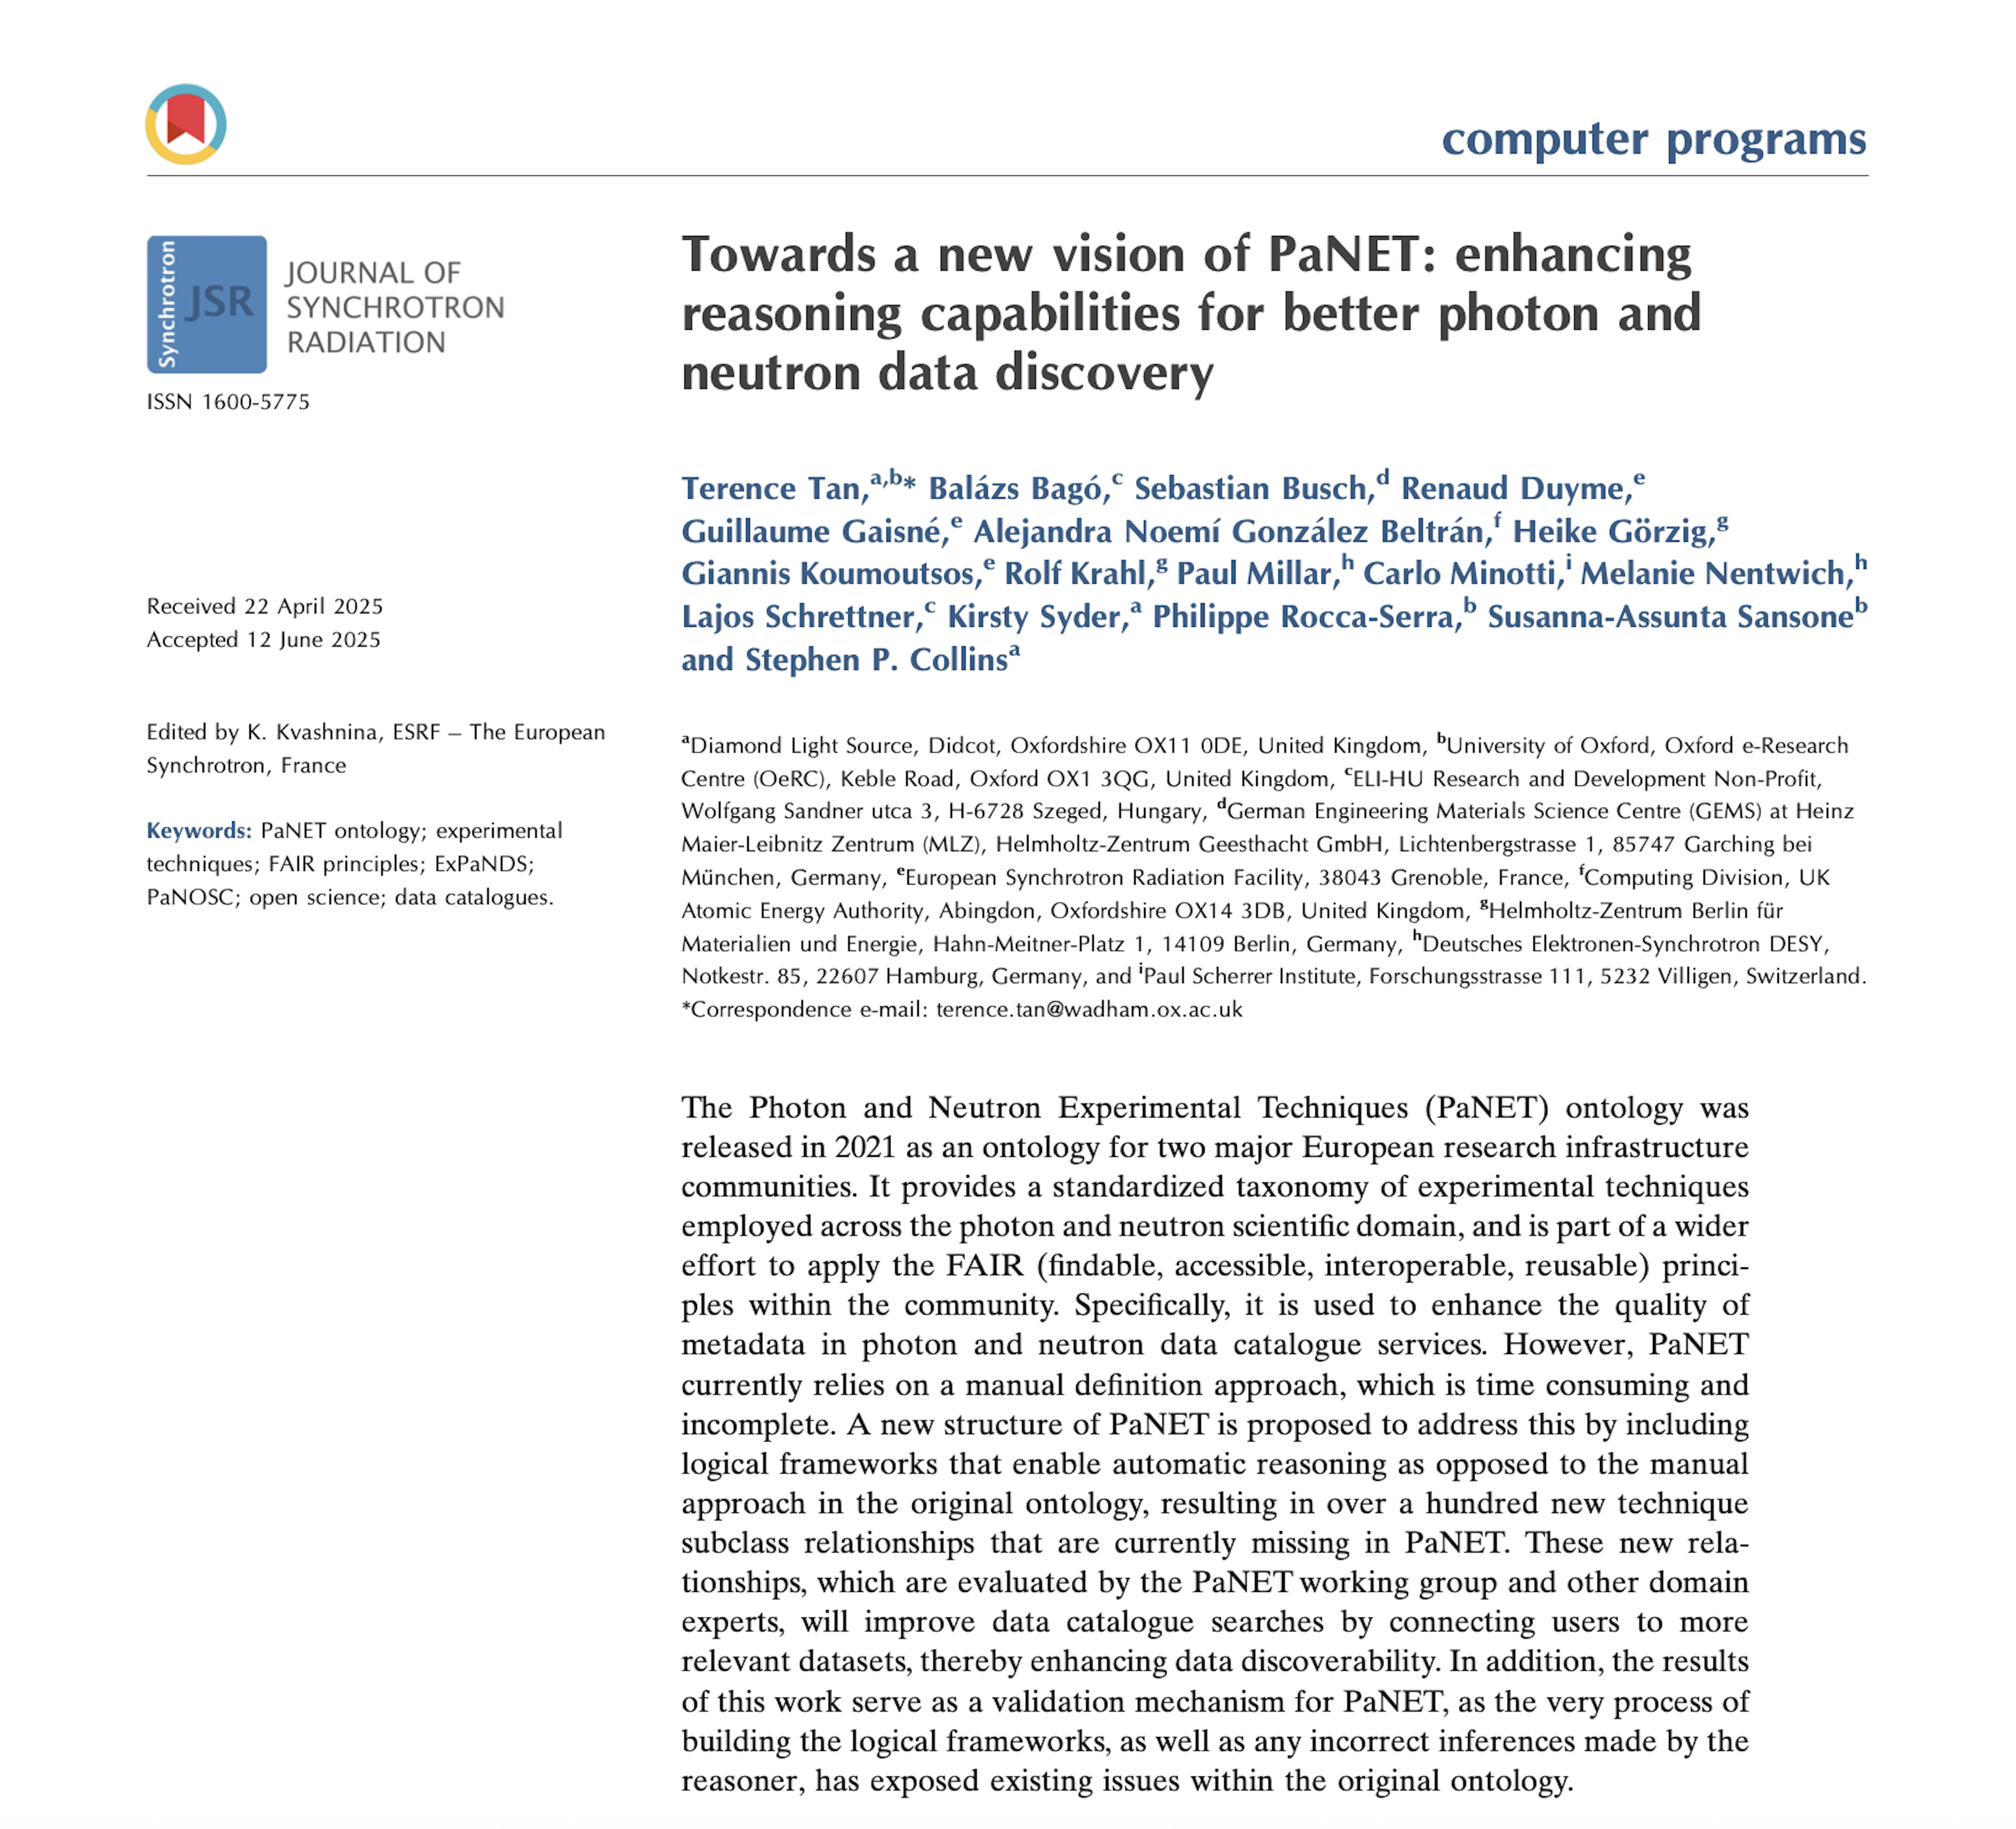
Activity #1 PaNET ontology
Issues
Maintenance-heavy
Missing subclass relationships
Results of restructuring
PaNET group - easier to maintain the ontology
Users – improved findability of experiment data
Tan, T., Bagó, B., Busch, S., Duyme, R., Gaisné, G., González Beltrán, A. N., Görzig, H., Koumoutsos, G., Krahl, R., Millar, P., Minotti, C., Nentwich, M., Schrettner, L., Syder, K., Rocca-Serra, P., Sansone, S.-A., & Collins, S. P. (2025). Towards a new vision of PaNET: enhancing reasoning capabilities for better photon and neutron data discovery. Journal of Synchrotron Radiation, 32(5), 1361–1369. https://doi.org/10.1107/s1600577525005272

Slide 8
x-ray probe
x-ray scattering
inelastic x-ray scattering
x-ray probe
x-ray scattering
inelastic x-ray scattering
Tan, T., Bagó, B., Busch, S., Duyme, R., Gaisné, G., González Beltrán, A. N., Görzig, H., Koumoutsos, G., Krahl, R., Millar, P., Minotti, C., Nentwich, M., Schrettner, L., Syder, K., Rocca-Serra, P., Sansone, S.-A., & Collins, S. P. (2025). Towards a new vision of PaNET: enhancing reasoning capabilities for better photon and neutron data discovery. Journal of Synchrotron Radiation, 32(5), 1361–1369. https://doi.org/10.1107/s1600577525005272

Slide 9
Activity #2 - Topic classification
Use machine learning model to assign topics to experimental proposals
Machine Learning model trained by OpenAlex team
Openly available proposals from the European Synchrotron Radiation Facility
Motivation
Enhanced metadata
Downstream applications

Slide 10
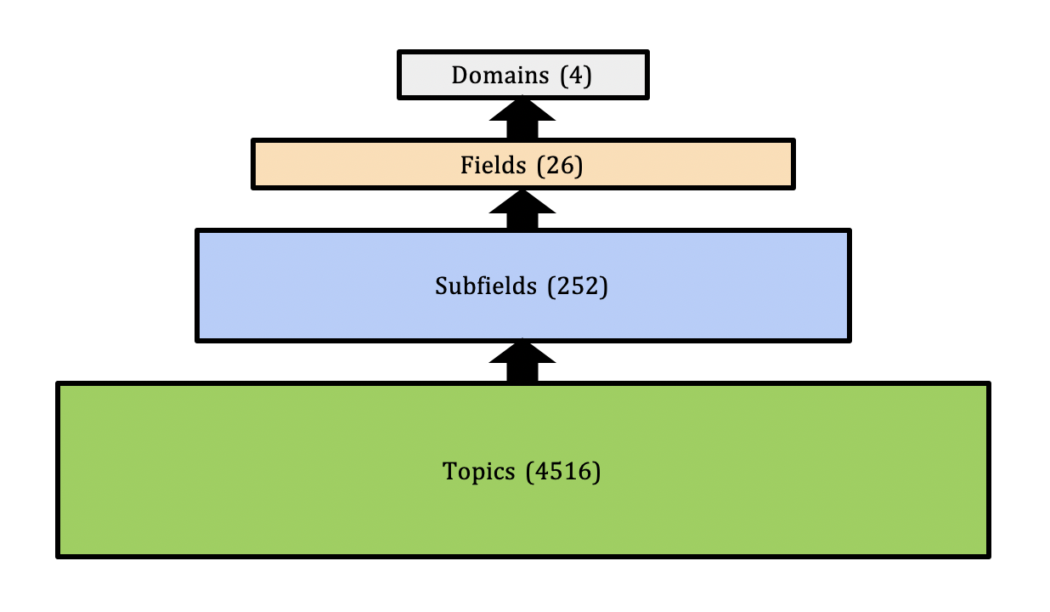
Topics
Life Sciences
Biochemistry, Genetics and Molecular Biology
Molecular Biology
Protein Structure and Dynamics

Slide 11
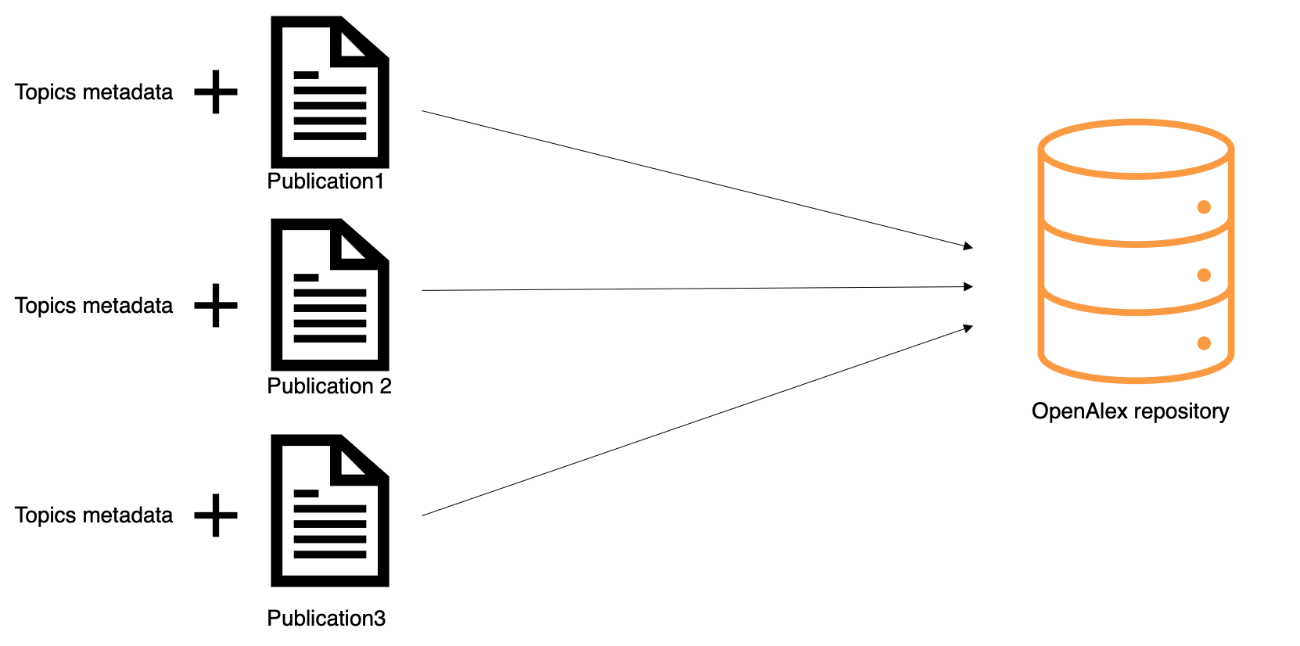
OpenAlex
Fully open catalogue of the global research system
Spiritual successor to Microsoft Academic Graph
Huge coverage
Works, authors, institutions etc.
Open and free unlike other industry-standard scientific knowledge bases such as Elsevier’s Scopus

Slide 12




Background – OpenAlex repository
New publication
OpenAlex repository

Slide 13
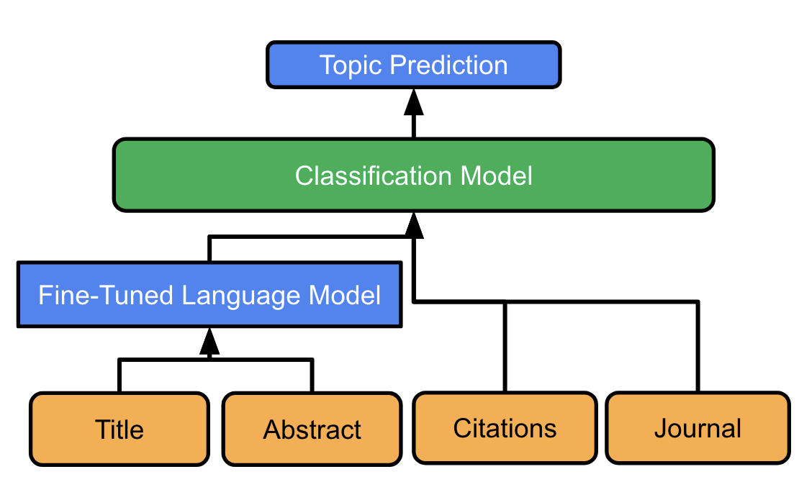
OpenAlex topic prediction model

Slide 14
My proposed evaluation exercise
209 ESRF proposals selected for evaluation
The ones with no missing titles, abstracts, references, and scientific disciplines
Each proposal independently evaluated by three reviewers
Qualitative assessment of predicted topics
Carried out over private SharePoint files

Slide 15
Proposal number | Title | Abstract | PDF | Scientific Discipline | Instrument | References
CH-5879 | Probing average and local structure in tin halide perovskites | In this experiment we plan to collect T-variable x-ray diffraction and PDF on a series of tin-based metal halide perovskite. Performing this experiment will be particularly important to access the average andlocal structure of tin-based halide perovskite of relevance for photovoltaics applications. We expect to clarify the structural stability and the sequence of phase transitions and make a correlation between average and local structures and compare these results to those already obtained by our group on the lead-based analogue materials. | https://ftp.esrf.fr/pub/UserReports/95410_A.pdf | Chemistry | ID11 – Materials Science beamline | Farrow, C. L., Juhas, P., Liu, J. W., Bryndin, D., Božin, E. S., Bloch, J., Proffen, T., & Billinge, S. J. L. (2007). PDFfit2 and PDFgui: computer programs for studying nanostructure in crystals. Journal of Physics: Condensed Matter, 19(33), 335219. https://doi.org/10.1088/0953-8984/19/33/335219 ……..
Topic 1 | Topic 2 | Topic 3 | Subfield 1 | Subfield 2 | Subfield 3 | Field 1 | Field 2 | Field 3
Perovskite Materials and Applications This cluster of proposals focuses on the advancements in perovskite solar cell technology, including the use of organometal halide perovskites as light sensitizers for photovoltaic cells, achieving high efficiency and stability, improving charge carrier transport, and exploring applications in light-emitting diodes. The research covers topics such as crystal growth, semiconductor properties, and optoelectronic materials. Keywords: Perovskite Solar Cells; Organometal Halide Perovskites; Photovoltaic Cells; Efficiency; Stability; Semiconductors; Light-Emitting Diodes; Crystal Growth; Charge Carrier Transport; Optoelectronic Materials https://en.wikipedia.org/wiki/Perovskite_solar_cell | Solid-state spectroscopy and crystallography This cluster of proposals explores the use of solid acids as fuel cell electrolytes, focusing on their protonic conduction and ferroelectric properties. The proposals cover topics such as high-temperature behavior, crystal structure, dielectric properties, phase transitions, and the application of nuclear quadrupole resonance in studying these materials. Keywords: Solid Acids; Protonic Conduction; Ferroelectricity; Fuel Cells; Electrical Properties; Crystal Structure; Dielectric Properties; Phase Transitions; Nuclear Quadrupole Resonance; High Temperature Behavior https://en.wikipedia.org/wiki/Solid_acid_fuel_cell | …… | Materials Chemistry | Electrical and Electronic Engineering | Electronic, Optical and Magnetic Materials | Materials Science | Engineering
Relevant | Not Relevant | Uncertain

Slide 16
Topic classification - reviewers
Each proposal takes between 5-10 minutes
Aiming for 10 experts who become co-authors of the final paper
About 5 hours of work spread over 2 months (average of 5 minutes per proposal); maximum 2 days of work
Ideally experts familiar with the proposal review process
Multi-domain expertise desirable

Slide 17
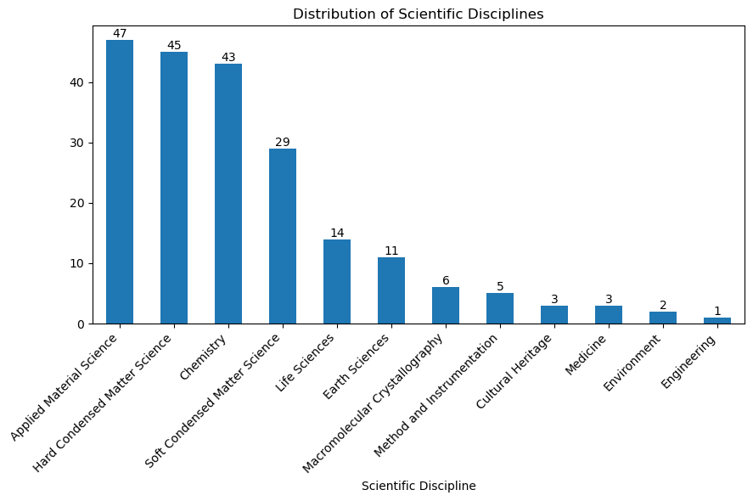

Slide 18
How you can help
What do you think about the plan?
Would you be willing to volunteer yourself or someone as a reviewer?

Slide 19

Activity #3 Proposal matching system
Automatically assign reviewers to proposals based on matched expertise
Tracks reviewer history to avoid consecutive assignments
Literature review
Charlin, L., & Zemel, R. (2013). The Toronto paper matching system: an automated paper-reviewer assignment system.

Slide 20

Activity #4 AI-ready data
Workflow data
Used or generated within Diamond's processing workflows, from the initial raw input through all intermediate processing steps
Curated data
Final archive-ready data package released to the wider scientific community

Slide 21
AI-ready data
Data
Pre-processing workflow
AI model
High-quality, accessible, and appropriate for AI use
Protein Data Bank
AlphaFold
Jumper, J., Evans, R., Pritzel, A. et al. Highly accurate protein structure prediction with AlphaFold. Nature 596, 583–589 (2021). https://doi.org/10.1038/s41586-021-03819-2

Slide 22
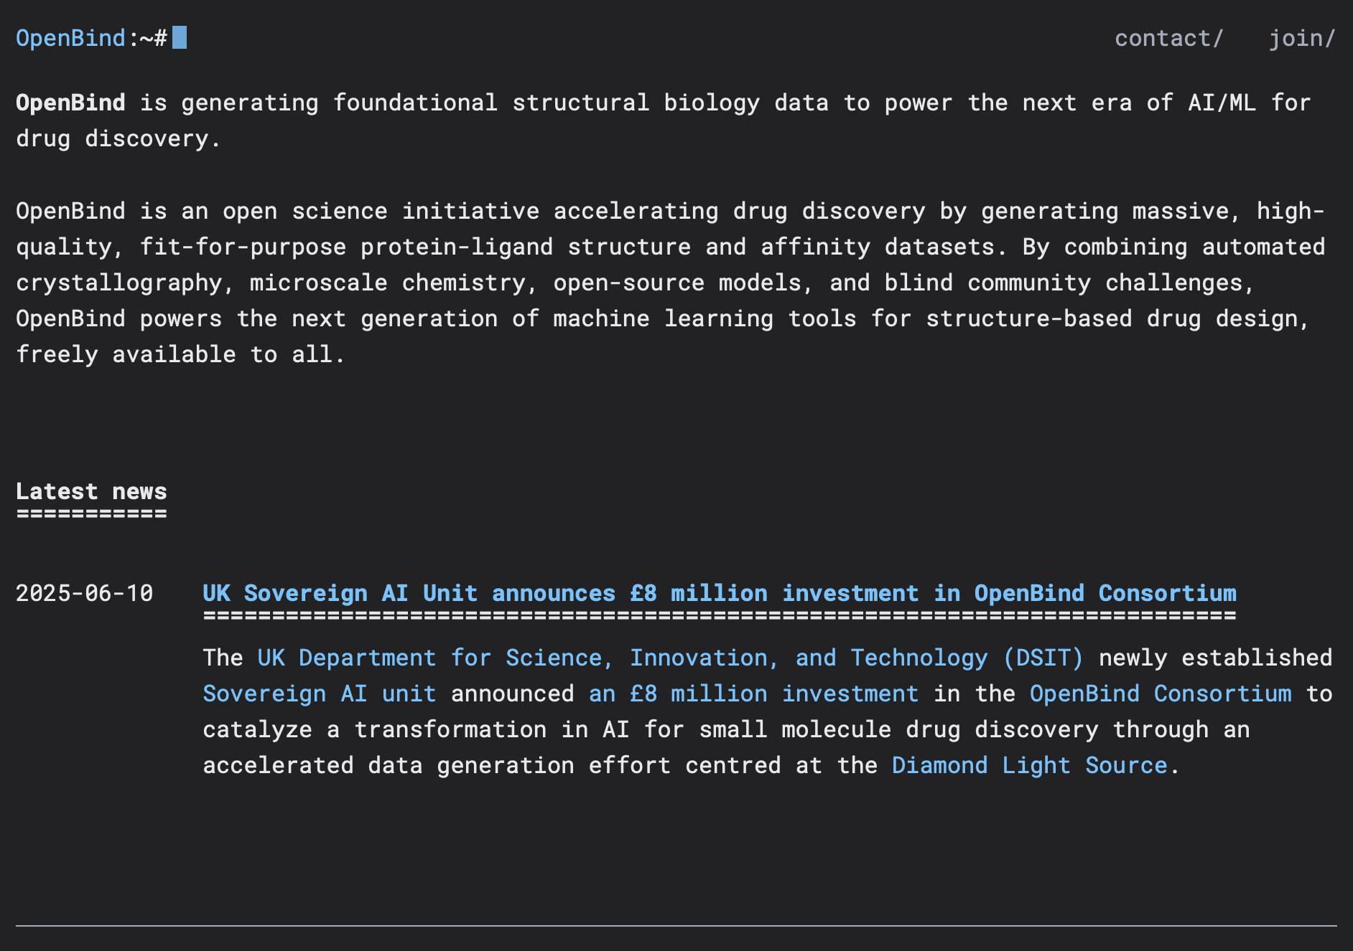
OpenBind
Initiative to generate large amounts of data to power AI for drug discovery
Centred at Diamond Light Source
Blueprint for this project
Initial chat with Warren
https://openbind.uk

Slide 23
Diamond research areas
Chemistry
Earth Sciences and Environment
Engineering and Technology
Life Sciences
Materials Science
Physics
Energy
Cultural Heritage

Slide 24
Methodology
Identify potential AI applications that would rely on synchrotron data
Literature Review: Systematically scanning the field for proven AI-driven research trends.
Stakeholder Interviews: Speaking directly with synchrotron facility staff to understand existing data products.
Expert Consultation: Engaging with machine learning experts to determine specific data requirements.
Developing and tailoring the framework to specific applications

Slide 25
AI-ready data metrics
Structured data
Completeness
Mislabels
Unstructured data
Lexical Diversity
Temp Importance
Readability Score
Topic Coherence
Outliers
Duplicity
Feature Relevancy
Class Imbalance
Class Separability
Discrimination Index
Data Split Ratio
Data Point Impact
Timeliness
Correctness
Privacy Leakage
Sample Size
FAIRness Score
Bias Indicator
Image Quality
Video Quality
Speech Quality
Multimedia Data
Textual Data
Hiniduma, K., Byna, S., & Bez, J. L. (2024). Data Readiness for AI: A 360-Degree Survey. arXiv. https://doi.org/10.48550/ARXIV.2404.05779

Slide 26

Thank you

Slide 27
Discussion
Proposal matching system
Feedback on general direction
Similar activities?
AI-ready data
Feedback on general direction
Any AI applications, e.g. protein structure prediction

